Slide 1



Hardware and Software Fundamentals of
Intelligent Computing
Systems

Slide 2
Lecture 17: Architectural Design of Operator Libraries

Slide 3
Outline
Principles
Dispatcher
DSL
Case Study

Slide 4
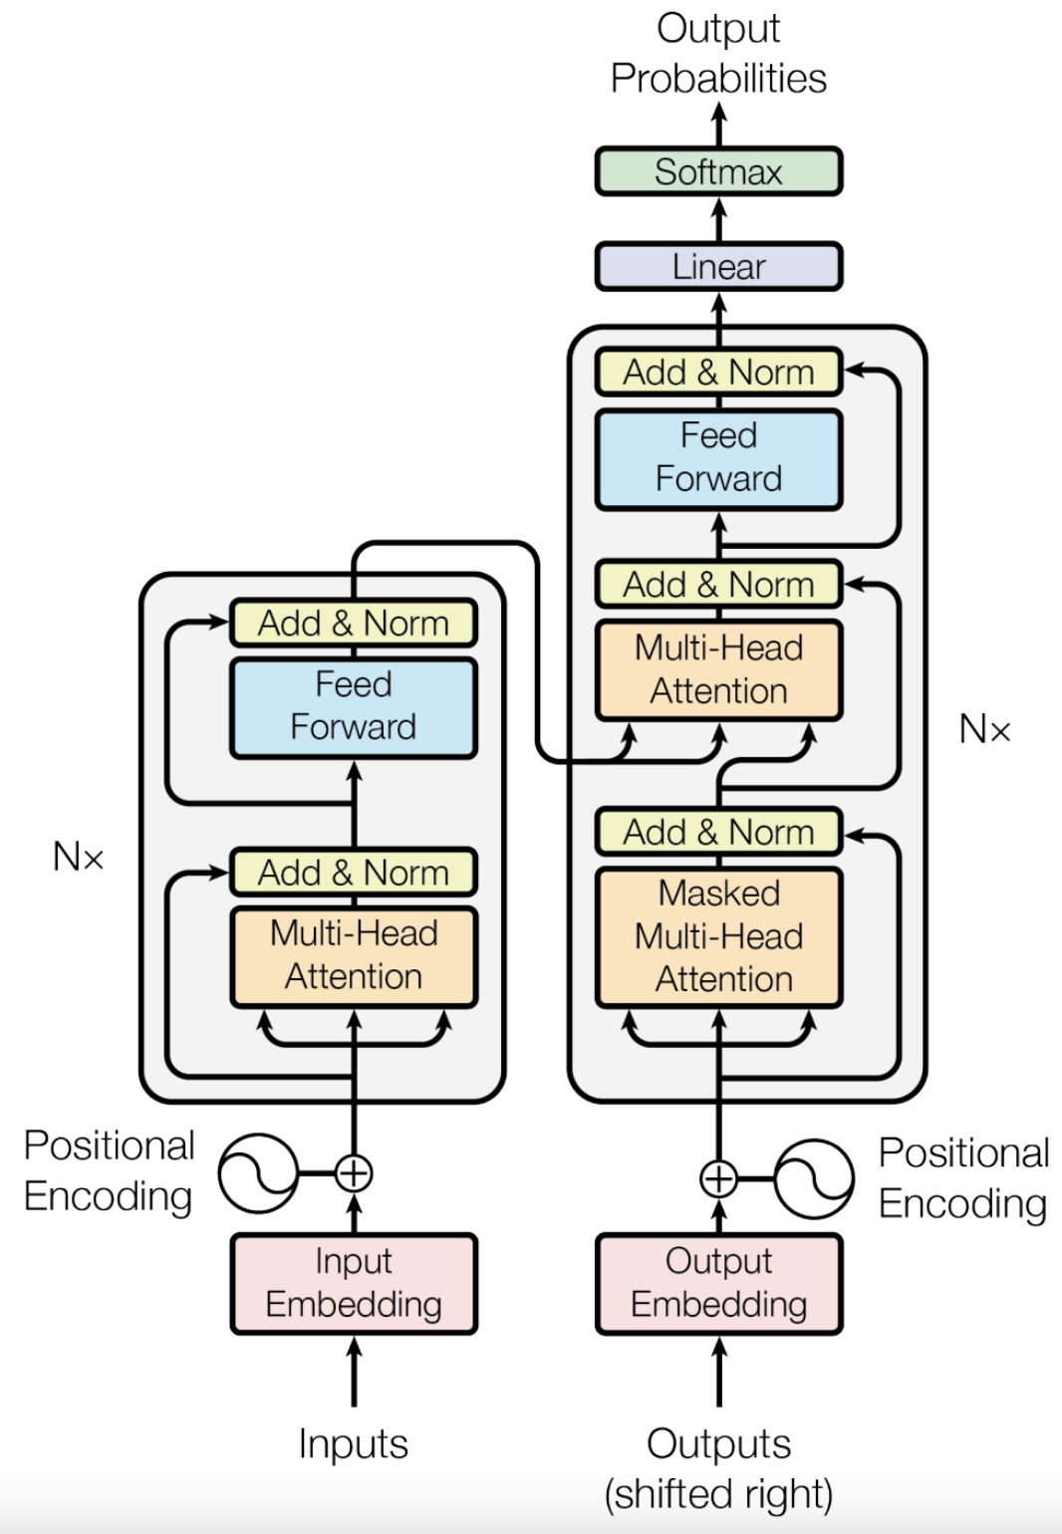
Operator
Broadly speaking, applying any specific operation to a given function can be defined as an Operator.
Deep learning algorithms are constructed from individual computational units known as Operators.
Examples: Add, MatMul, LayerNorm

Slide 5
Operator Library
Deep Learning Framework
A collection of highly optimized, reusable computational building blocks (Operators) for neural networks.
Core Roles:
  The Bridge - Connects high-level AI frameworks with low-level bare-metal hardware.
  Performance Extractor - Maximizes hardware utilization via expert-level kernel tuning.
  Hardware Abstraction - Shields algorithm developers from complex low-level programming.
Operator Library
Compiler
Hardware

Slide 6
Design Principles - Usability
Seamless Integration with High-Level Frameworks
  Register the operator library directly into the framework's internal dispatch mechanism to allow existing models to benefit from acceleration with zero code modifications.
Automatic Hardware Discovery
  Implement runtime detection of the execution environment to automatically load the optimal backend without requiring manual user configuration.
Uniform Interface for Diverse Backends
  Define a standardized abstraction layer so that the same high-level API remains consistent across a wide variety of hardware architectures
Multi-Level Abstraction Architecture
  Offer a tiered abstraction system to meet diverse needs: high-level for rapid prototyping, mid-level for tuning parallelism and tiling, and low-level for expert optimization of hardware specifics like registers and warps
Notes:
https://github.com/flagos-ai/FlagGems

Slide 7
Design Principles - Performance
Persistent Caching and Pre-Tuning
  Store optimized computational configurations and pre-warm kernels to eliminate initialization delays and ensure peak performance from the very first execution.
Hardware-Aware Configuration Mapping
  Utilize a configuration system that abstracts hardware-specific constraints, such as memory hierarchy and compute unit limits, into the code generation process.
Adaptive Tiling
  Decomposes operators into optimal compute tiles based on input dimensions, minimizing padding overhead and maximizing memory bandwidth utilization across variable sequence lengths.
Notes:
https://github.com/flagos-ai/FlagGems

Slide 8
Trade-off
Dynamic Shape vs. Hardware Alignment
  Arbitrary input sizes often limit hardware-aligned peak performance
  Solution: Adaptive Tiling
Intuitive Layout vs. Optimal Memory Access
  Standard data formats often conflict with hardware-optimized memory patterns
  Solution: Layout Transformation
Black-box API vs. Fine-grained Tuning
  Simplified interfaces hide the tuning knobs needed for expert optimization
  Solution: Heuristic Mapping
A dispatch mechanism is required to manage these automated solutions and bridge the gap between user intent and hardware execution.

Slide 9
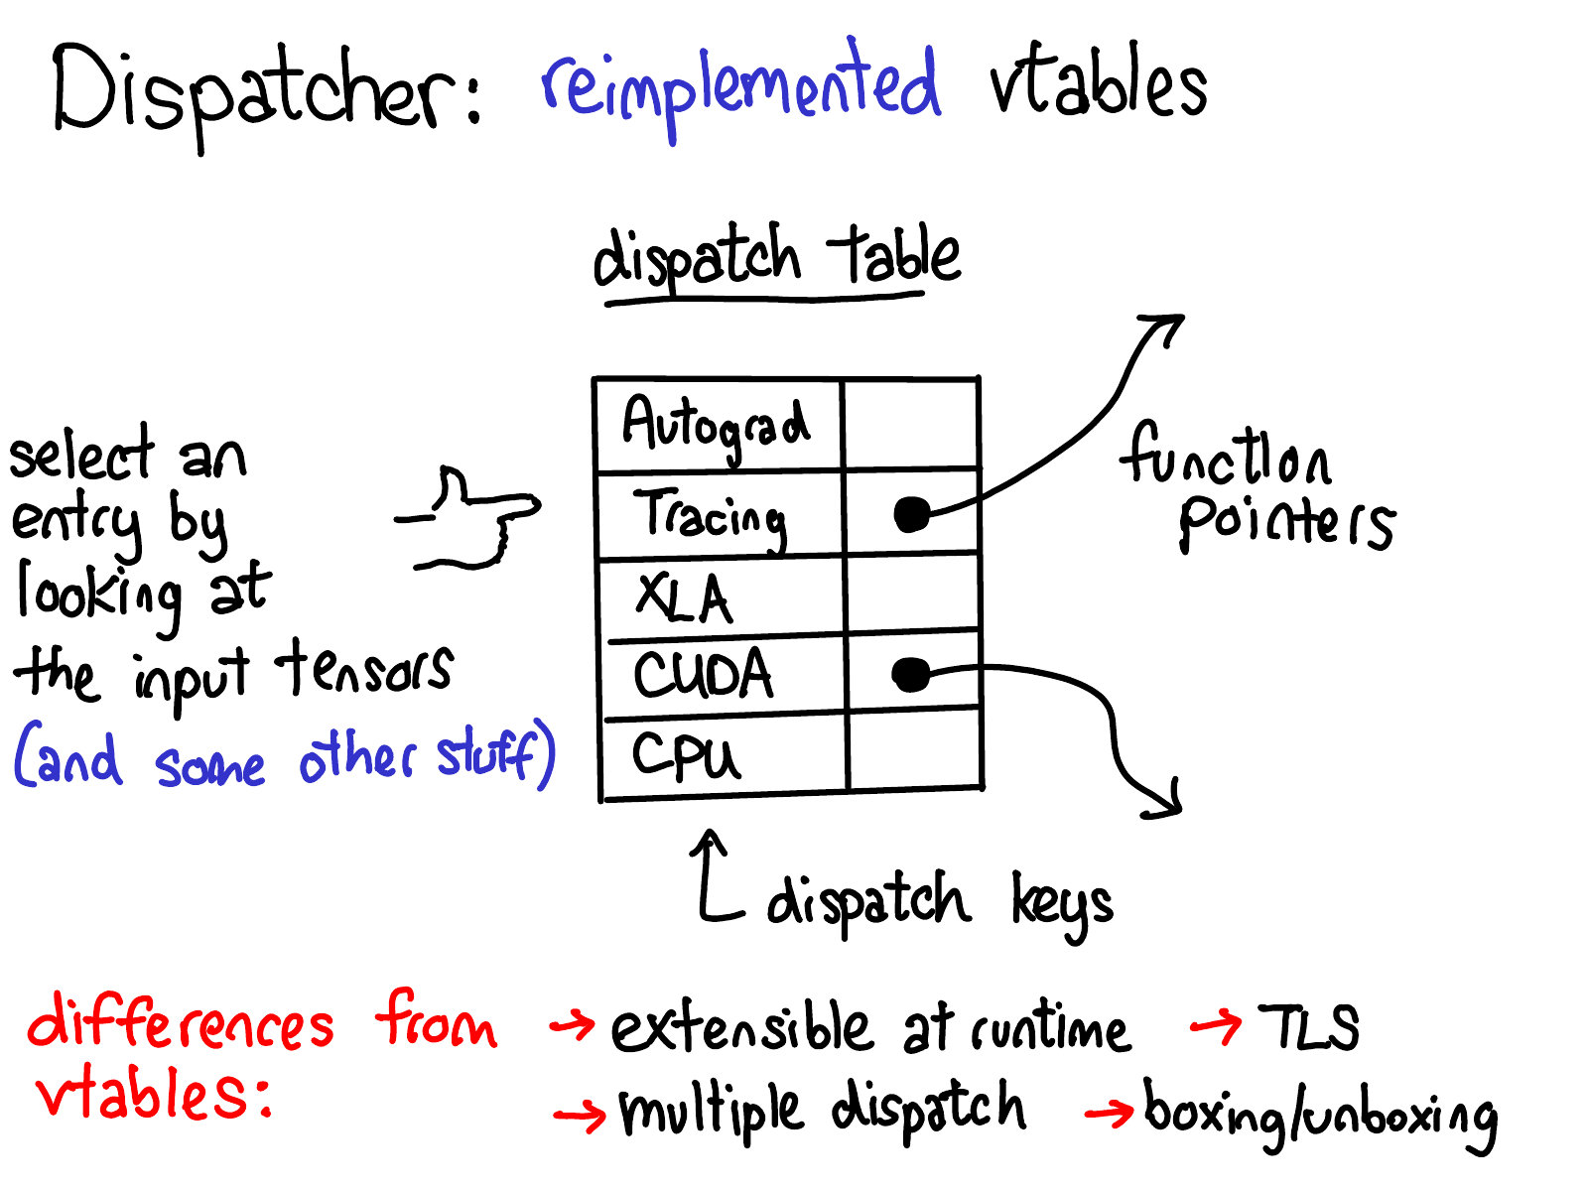
Dispatcher
A dispatcher is a component that routes an operation to the appropriate implementation or backend based on runtime criteria such as device type, data properties, or configuration policies.

Slide 10
Simplified Dispatch Workflow
1. Metadata Collection
  Extract metadata such as device, data type, and layout from input tensors
2. Key Computation
  Combine multiple attributes to generate a unique Dispatch Key
3. Table Lookup
  Search the global Dispatch Table for the corresponding kernel function pointer
4. Execution
  Invoke the specific backend implementation to perform the computation

Slide 11
Advanced Dispatching Mechanisms
Sequential Re-dispatching
  A single operator call can trigger a chain of handlers by masking processed keys and re-invoking the dispatcher to find the next implementation.
Heuristic Implementation Selection
  Profile workload metrics (e.g., shapes) and hardware attributes (e.g., SM counts) to adaptively select optimal algorithm paths and execution parameters.
Dynamic Kernel Instantiation
  Specialized kernels can be generated and cached on-the-fly to handle various task dimensions or broadcasting patterns without manual coding.

Slide 12
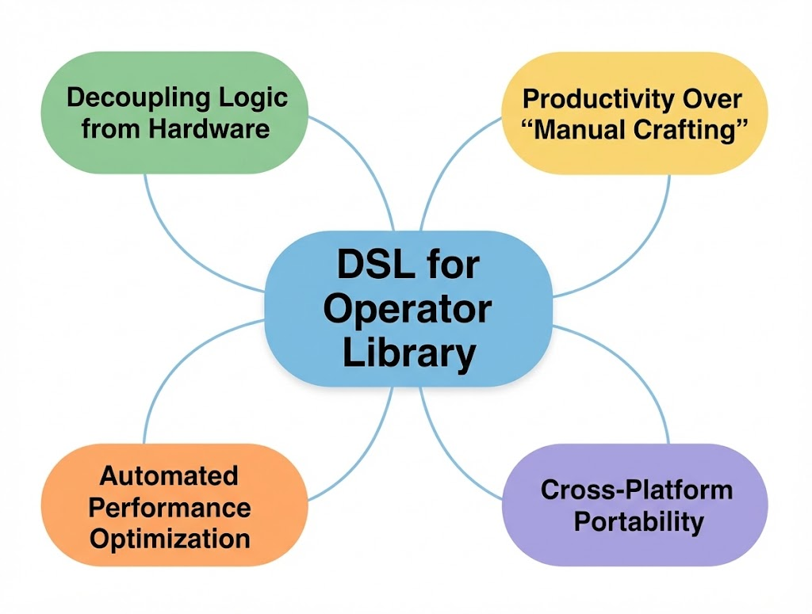
Use DSL to Implement Operator Libraries
Developers describe “what to do,” while the compiler determines “how to do it.”
A total separation between operator logic and physical implementation
Core Objective: Make operator development simpler and more efficient while ensuring cross-platform portability
Examples: Triton, TileLang, Gluon

Slide 13
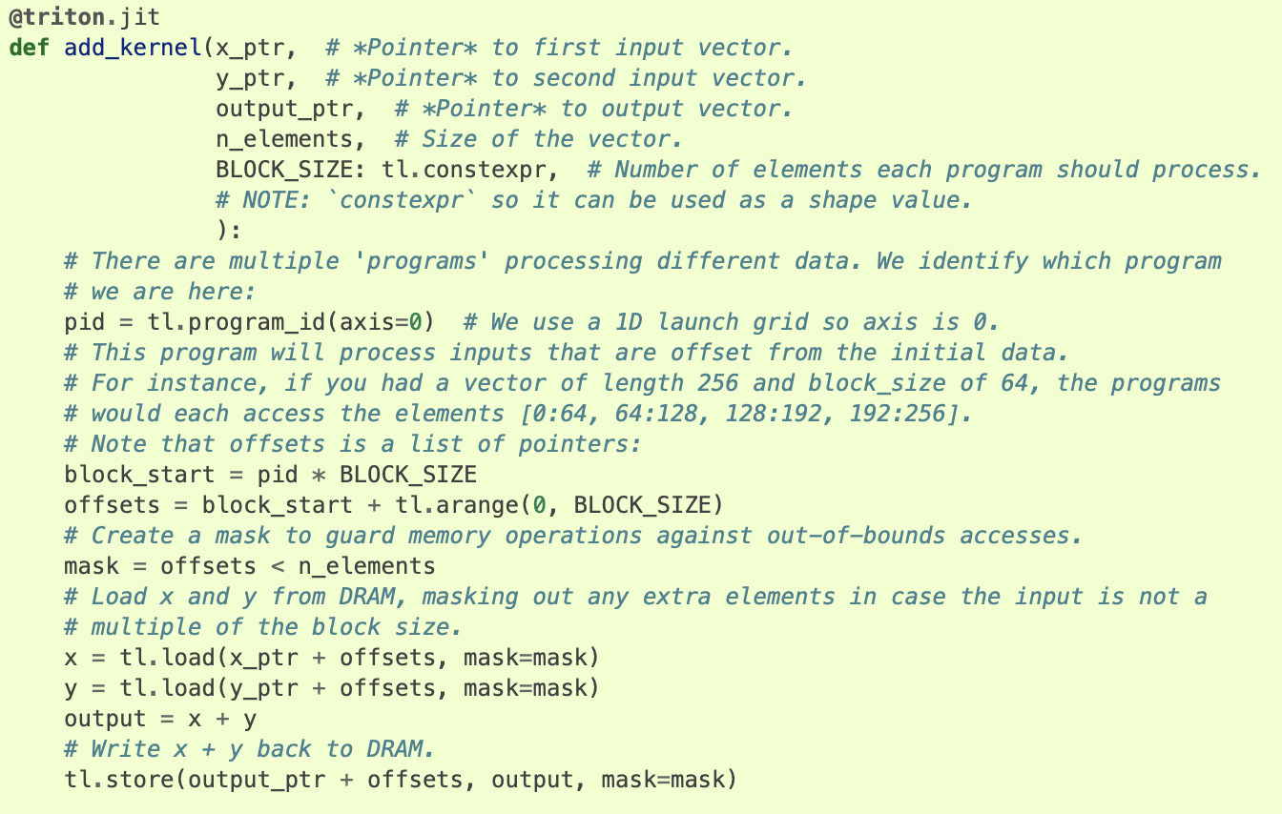

DSL for Operator Library - Triton
Python-Based Tile Programming
Compiler-Driven Optimization
Hardware-Agnostic Abstraction

Slide 14
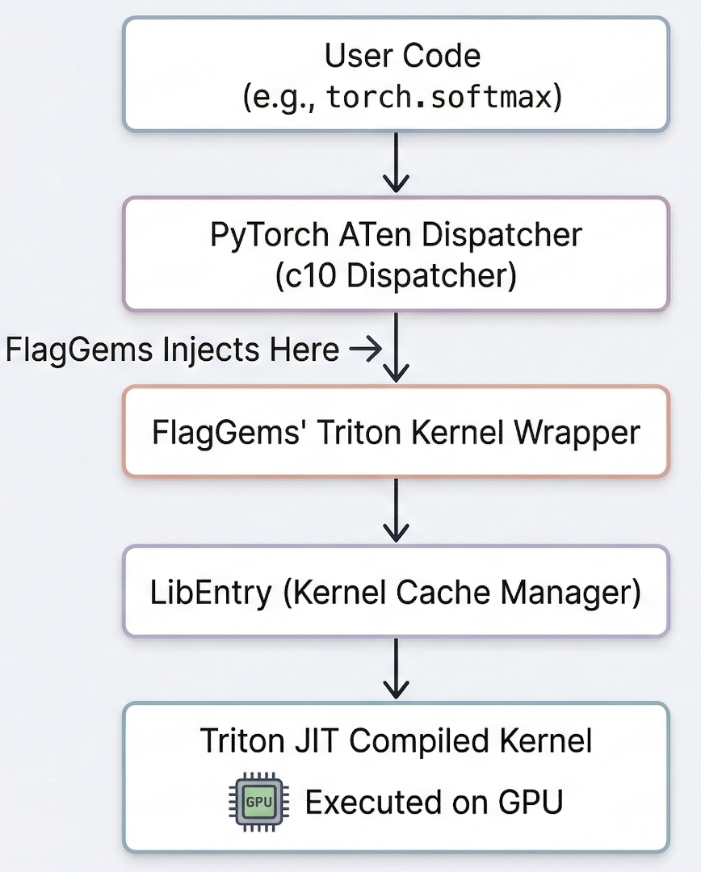
Case Study: FlagGems
Transparent ATen dispatcher injection
CUDA-to-Triton kernel replacement
Zero user code modification

Slide 15
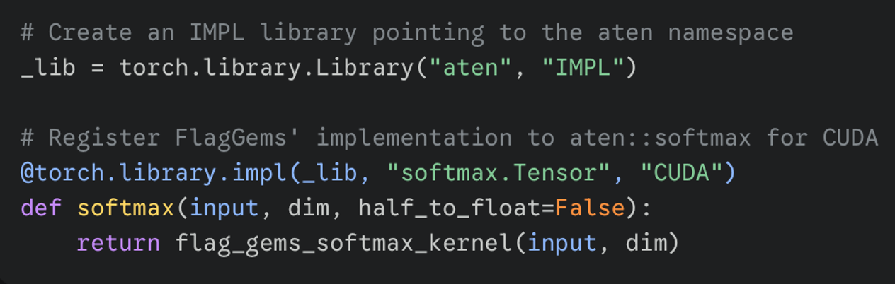
Operator Injection
"IMPL" mode override execution
Existing ATen operator interception
Specific dispatch key routing

Slide 16
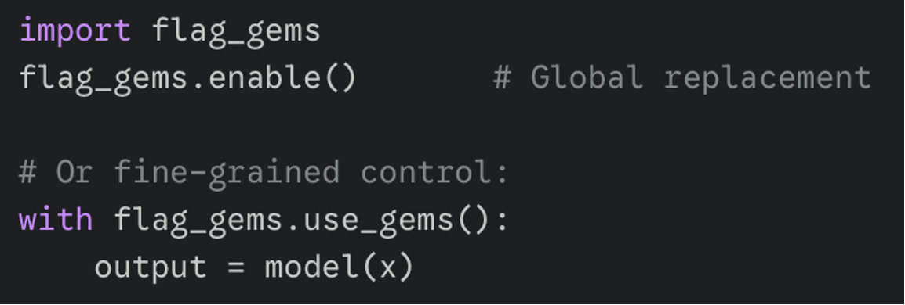
Global and Contextual Replacement
FlagGems maintains an operator registry.
enable(): Traverses the registry and registers operators.
use_gems(): Context manager for fine-grained operator replacement control.

Slide 17
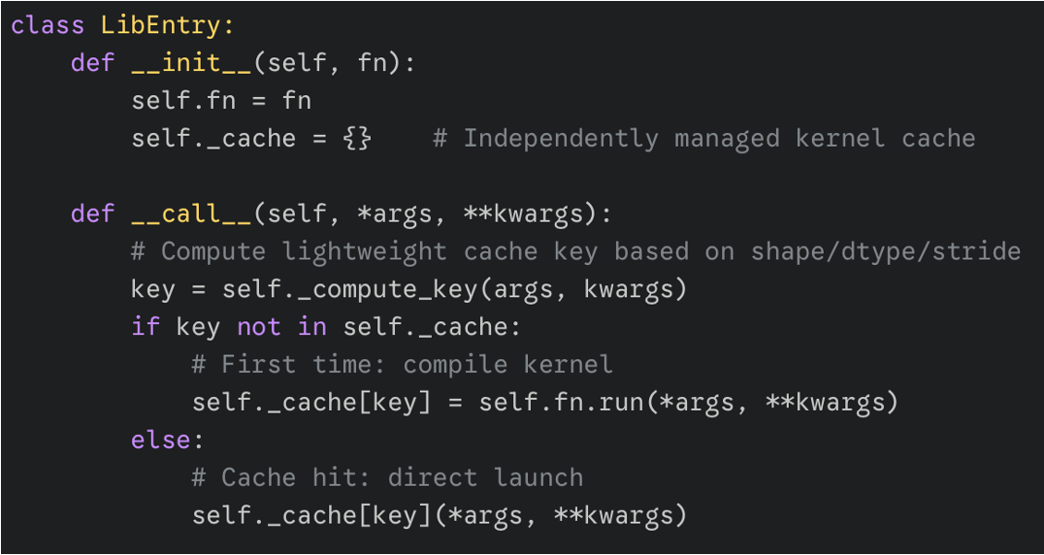
LibEntry: Kernel Cache Manager
Native Triton runtime bypass
Independent kernel cache management
Lightweight cache key computation
Near-zero subsequent Python overhead

Slide 18
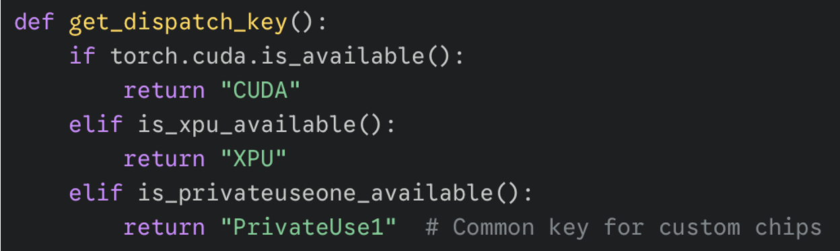
Multi-Hardware Dispatch Strategy
Dynamic runtime environment detection
Hardware-specific dispatch key routing
Unified Triton codebase execution

Slide 19
Takeaways
API Transparency
  Native framework APIs remain completely unchanged while transparently routing to optimized kernels.
Hardware Decoupling
  Utilizing dynamic dispatch keys provides a unified, scalable path for supporting diverse backend chips.
Execution Overhead
  Custom cache managers like LibEntry bypass native runtimes to nearly eliminate Python dispatch delays.
Kernel Generation
  Dynamic decorators present a streamlined approach for automatically generating and tuning fused operations

Slide 20
References
flagos-ai/FlagGems
Triton documentation
NVIDIA cuDNN Documentation
Let's talk about the PyTorch dispatcher : ezyang's blog

Slide 21

The Solution: FlagOS, a Unified AI Software Stack

Slide 22








https://space.bilibili.com/3546791834290849
https://github.com/flagos-ai
https://www.zhihu.com/people/95-22-20-18/posts
https://flagos.io/Home

Slide 23

Thanks for your time！

